Slide 1
529 Data Analytics
October 25, 2016
Analysis of Personal Income
Aishwarya Ravi, Hong Zhang

Slide 2
Table of Contents
Business Scenario and Objectives
Data Selection and Cleansing
Exploratory Data Analysis Results
Basic Statistics for Continuous Variables
Association between response and predictor
Statistics for Categorical Variables
Association between response and predictor
Chi-Square Test : income >= $56,210
Regression Modeling Results
Person’s Income Prediction
Median Income Prediction
Conclusions

Slide 3

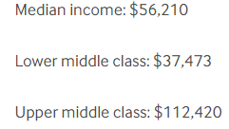
Business Scenario and Objectives
Business Scenario:
Everybody care about the same question how I can earn more money. "Success is a learnable skill," emphasizes T. Harv Eker in his book "Secrets of the Millionaire Mind." If you want to learn how to get rich — how to grow and master your money — consider these variables which can affect your income. If you want to be one person in Median income or upper middle class? What should I do?
Objectives:
What are the predictor variables that are significant in determining the person’s income (Person’s Income)? The variables considered are SEX, Education, Occupation, Country, Marital status, Worked For, Has Children, Worked hours per week and Age.
What are top 3 degrees(Education) more likely to get Person’s Income > $56,210 (Median Income)?
What are top 3 occupations (Occupation) more likely to get Person’s Income > $56,210 (Median Income)?

Slide 4
Selected Data and Data Cleansing Understanding of data set
The data set contains the data of American Community Survey 2010-2014 ACS 5-year PUMS.
http://www.census.gov/programs-surveys/acs/data/pums.html
File name: psam_p17.sas7bdat
Row Count: 635532
Time Period: 2010-2014
Data set has 293 variables out of which
10 variables are considered for analysis.
Data Cleansing:
Used ADJINC(Adjustment factor
for income and earnings dollar
amounts
to get current PINCP(Income).
PINCP=PINCP*(ADJINC/1000000)
Created a variable “bonus” for Median Income >=$56,210 and Deleted Age <= 16, WKHP <= 0 and Income <= $100.

Slide 5
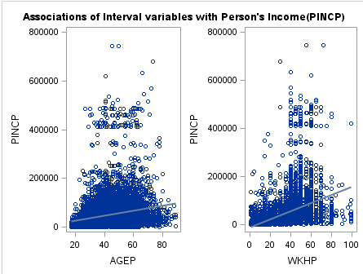

Exploratory Data Analysis Basic statistics for Continuous Variables
The relationship between Income and Worked hours per week has a better linear relationship when compared to Age, because it has a better R-square value (0.124) and p<0.05 which rejects null hypothesis i.e. slope is not horizontal.
Age shows a little bit association with the person's income but, still there is no much significance in their relationship.

Slide 6
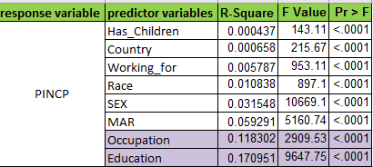
Exploratory Data Analysis Association between response and predictors
The below table lists 8 categorical variables which have more impact on person’s income. Table shows
Occupation and Education have more influence on the person’s income. R-square value of Occupation = 0.11; R-square value of Education = 0.17.
Whereas, Has Children, Country, Working For and Race have nearly R-square (0) impact on income. Hence, these variables are not a significant predictor.
Sex and Marital Status individually shows bit low variability in person’s income with R-square values of 0.03 and 0.06 respectively.
Occupation and Education are used to further investigation..

Slide 7
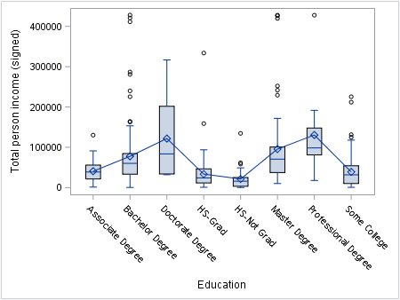
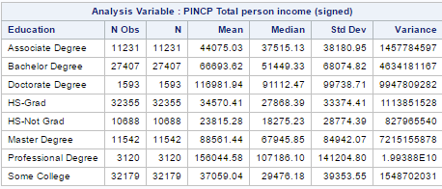
Exploratory Data Analysis Statistics for categorical variables
Also, mean of person’s income is highest for person with professional degree and lowest for a HS-Not Graduate. So maximum income is for person with a professional degree.

Slide 8
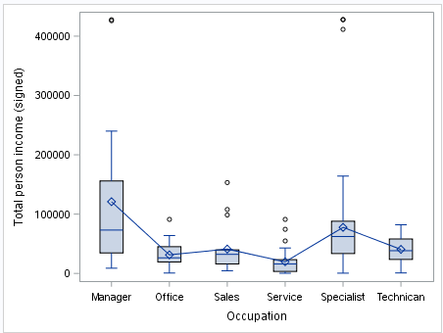
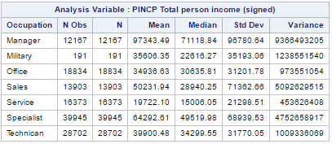
Exploratory Data Analysis Statistics for categorical variables
Mean of person’s income is highest for Manager and lowest for Service. So maximum income is for person who is a manager.
8

Slide 9
Exploratory Data Analysis Chi-Square Test: income >= $56,210
To study the chance of making more than $56,210 based on the person’s information, the Pearson chi-square test is conducted.
Table listed the p-values of eight variables for the chi-square statistic. It can be conclude that there is an association between these variables and income.
Cramer’s V indicates that the association detected with the chi-square test is relatively weak. Occupation and Education have more influence on income>=$56,210.

Slide 10
Regression Modeling Results WKHP*Education*Occupation vs Income
Overall, Education, Occupation and WKHP factors have better influence on Income as they explains 17% ,12% and 12% of variability respectively from the exploratory analysis.
Overall interaction of Worked hours per week*Education*Occupation shows 30% of variability in Income i.e. these variables together shows more influence on Person’s Income change. It means for any Occupation/Education, if number of hours worked fluctuates then accordingly Person’s Income will change and that variation in Income is more influenced by combined effect of these 3 factors rather than individual effect as these factors are correlated to each other.

Slide 11
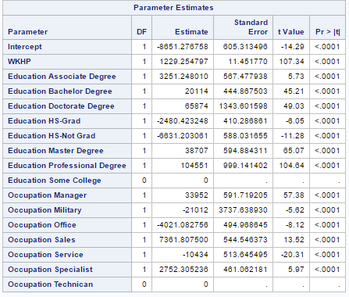
Regression Modeling Results WKHP*Education*Occupation vs Income
The constant is -8651.2 when Education: Some college and Occupation: Technician is 0.

Slide 12
Regression Modeling Results WKHP*Education*Occupation vs Income
Regression Equation to Predict Person’s Income:
Person's Income = -8651.27 + 1229.25 * WKHP + 3251.24 * Associate +
20114 * Bachelors + 65874 * Doctorate + (-2480.4) * HS-Grad +
(-6631) * HS_Not Grad + 38707 * Masters +104551 * Professional +
33952 * Manager + (-21012) * Military + (-4021) * Office + 7361.8 * Sales +
(-10434) * Service + 2752.3 * Specialist
For instance, Worked hours per week = 40, Education = Masters and Occupation = Manager, then Person’s Income is calculates as :
Person's Income = -8651.27 + 1229.25 * 40 + 38707 + 33952 = $113,175.73
For instance, Worked hours per week = 40, Education = Masters and Occupation = Sales, then Person’s Income is calculates as :
Person's Income = -8651.27 + 1229.25 * 20 + 38707 + 7361.8 = $86587.53

Slide 13
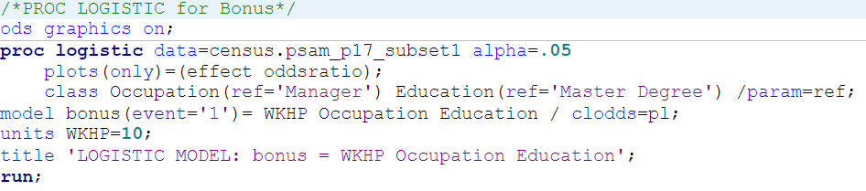
Logistic Regression Modeling Results income >= $56,210
Run LOGISTIC procedure to find the best fit model to predict the complex effects of interval and categorical predictors.
For every Model, the convergence criterion was met.
Comparing these models’ SC value, the model of Worked hours per week , Occupation, Education and bonus (income >= $56,210) is better fitting.

Slide 14
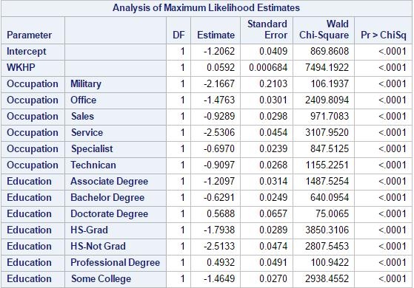
Logistic Regression Modeling Results income >= $56,210
This model is statistically significant, indicating all predictors in the model is useful in predicting bonus.
If you are a person who has a Master Degree and is a manger, the odds of getting the income more than $56,210 increase by 5.92% for each working 10 hours more per week.
The logistic regression equation is logit( ) = -1.2062+(0.0592)*WKHP+
(-2.1667)*Military+(-1.4763)*Office+(-0.9289)*Sales+(-2.5306)*Service+
(-0.6970)*Specialist+(-0.9097)*Technician+(-1.2097)*Associate Degree+
(-0.6291)*Bachelor Degree+(0.5688)*Doctorate Degree+(-1.7938)*HS-Grad+
(-2.5133)*HS-Not Grad+(0.4932)*Professional Degree+(-1.4649)*Some College

Slide 15
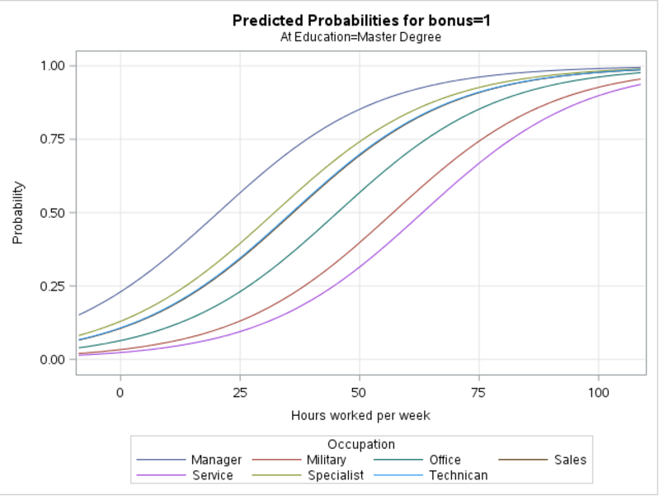
Logistic Regression Modeling Results income >= $56,210
For Example,
Occupation = Specialist, Education = Master Degree.
The logistic regression equation is logit( ) = -1.2062 + (0.0592) * WKHP + (-0.6970) * Specialist
The odds ratio is
e^(-0.6378) = 0.52845
Comparing the person who has a Master Degree and is a Manger, you have less chance of getting the income more than $56,210. Because, the odds ratio is only 0.52845 time for each working more 10 hours per work.

Slide 16
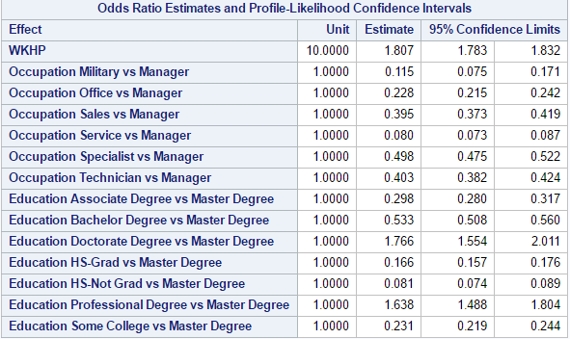
Logistic Regression Modeling Results income >= $56,210
The odds ratios show that, adjusting for the other predictor variables.
For example, the person with Doctorate Degree had 1.766 times the person with Master Degree to get the income more than $56,210.
Top 3 Education
Eligible for Income >$ 56,210 :
Doctorate Degree
Professional Degree
Master Degree
Top 3 Occupation
Eligible for Income >$ 56,210 :
Manger
Specialist
Technician

Slide 17
Conclusion
Education, Occupation and Worked hours per week had better impact on person’s Income. So, with the linear regression results we were able to justify the answer with the better R-square value (30%) and box plots.
Top 3 degrees more likely to get income> $56,210 were
Doctorate Degree
Professional Degree
Master Degree
Top 3 Occupations more likely to get income> $56,210 were
Manger
Specialist
Technician
A mathematical model to predict person’s income and a mathematical model to predict the chance to earn more than $56,210 using Education, Occupation and Worked hours per week were developed.
17

